Slide 1
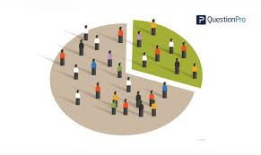

DEMOGRAPHIC PROFILE ANALYSIS
By Marc Arnaud KAMBOU
Supervised by Arkar MIN
Presented: Monday, June 1st 2020

Slide 2
PRESENTATION OUTLINE
Background/Introduction
Objectives
Methodology
Conceptual Framework/Variables of the study
Descriptive Analysis
Research Question(s)/Hypothesis(Inferential/Predictive)
Results/findings
Conclusions
Recommendations
Appendix

Slide 3
BACKGROUND/INTRODUCTION
The dataset is Washington State Demographic Data (Census) collected in 2013
Demographics cover different aspects of life: youth, religion, housing, employment, taxes and mortality
Number of observations : 17967
Number of variables : 234

Slide 4
OBJECTIVES
The Washington State social department is preparing for their annual budget. The main objective of the study is to identify meaningful insights that will determine where the department should invest. Two secondary objectives can be note based on the fact that the department is targeting more the persons with disabilities and the unemployed people:
In which area of the state the department should prioritize the investment for people with disabilities?
What factors increase the unemployment rate and what investment can be done?

Slide 5
METHODOLOGY
Only selected 10 variables for the study framework and drop the others
Group ages in 5 groups: kids, youth, young adult, adult and senior
Group education levels in 4 groups: lower level, middle level, high level and very high level
Missing values have been treated has another categorical column or grouped with 0 in some cases
No outliers
Created new variable disable from 7 other variables
Software: SAS 9.4

Slide 6
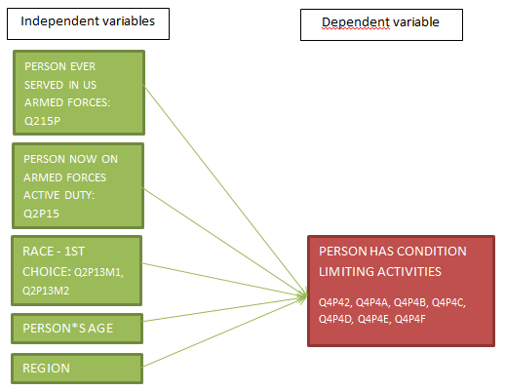

CONCEPTUAL FRAMEWORK
1) In which area of the state the department should prioritize the investment for people with disabilities?

Slide 7
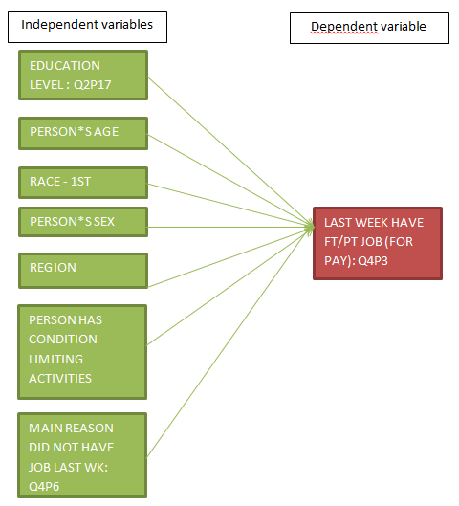
CONCEPTUAL FRAMEWORK
2) What factors increase the unemployment rate and what investment can be done?

Slide 8
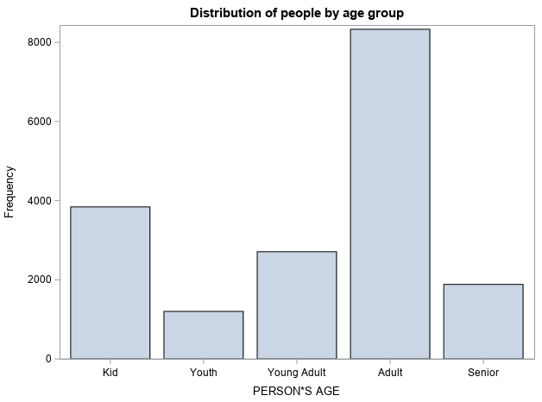
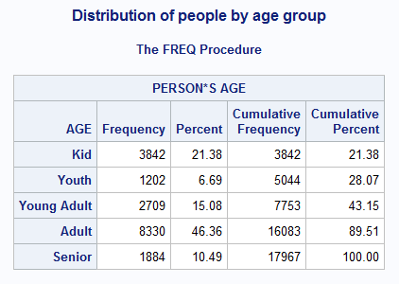
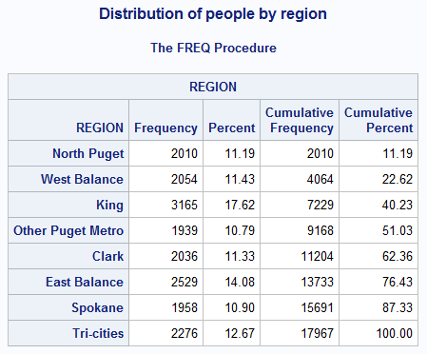
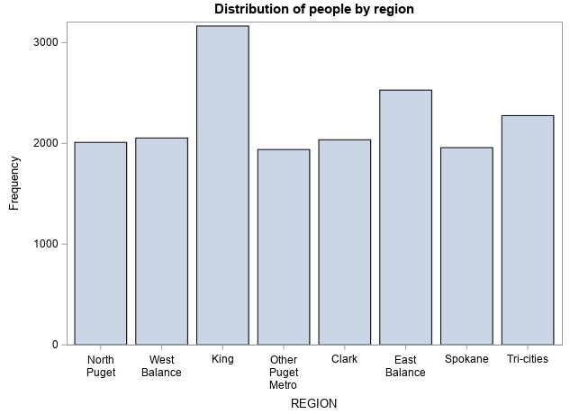
DESCRIPTIVE ANALYSIS

Slide 9
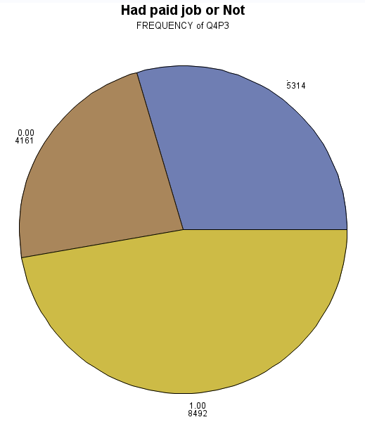
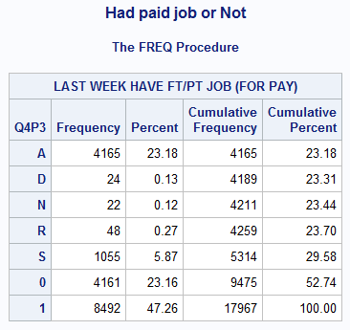
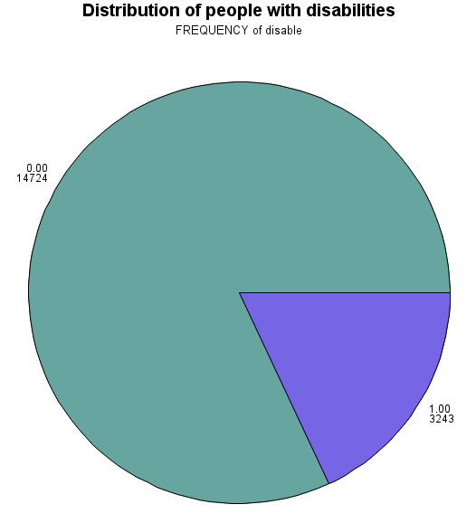
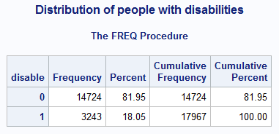
DESCRIPTIVE ANALYSIS
Missing
Target: 18.05% of people with disabilities

Slide 10
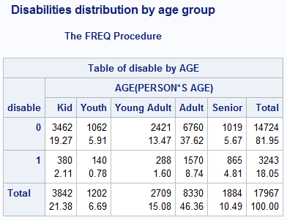
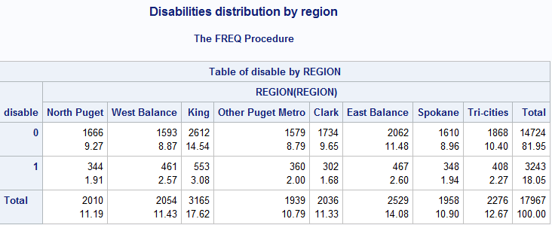
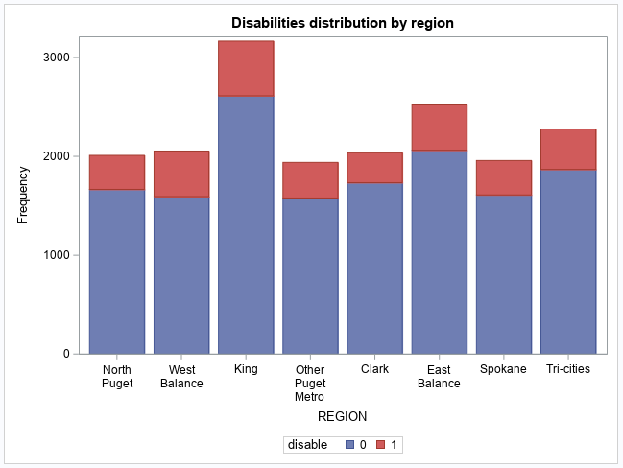
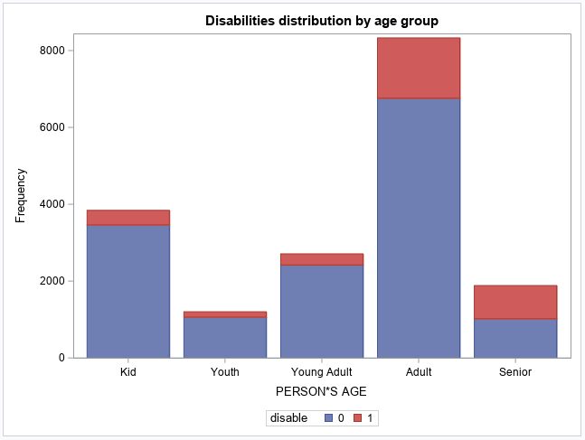
DESCRIPTIVE ANALYSIS
45.6%

Slide 11
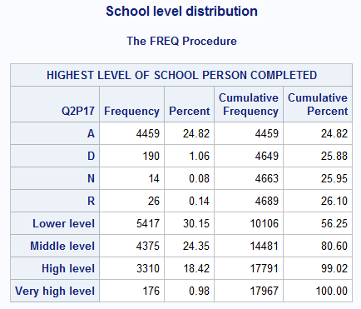
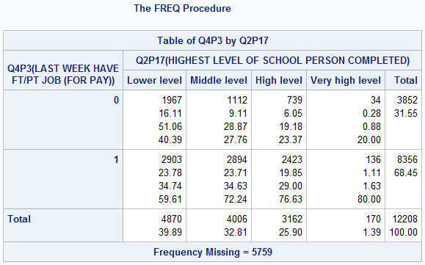
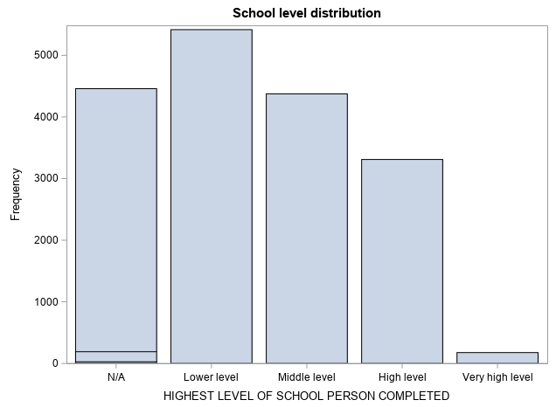
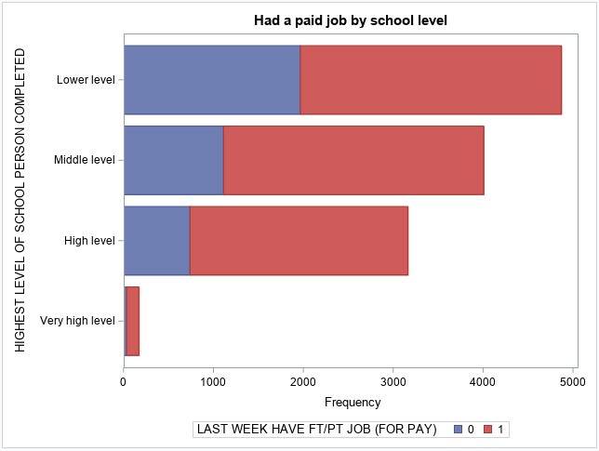
DESCRIPTIVE ANALYSIS

Slide 12
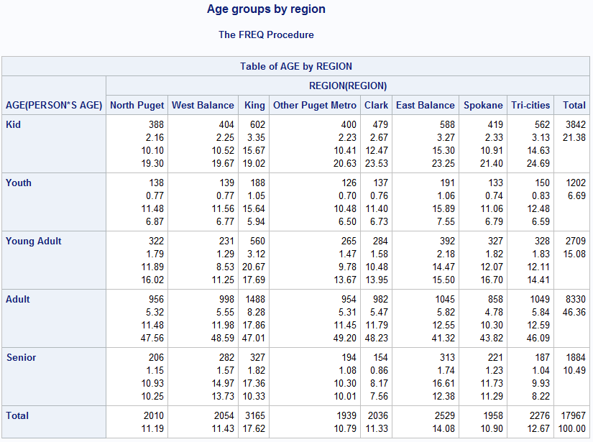
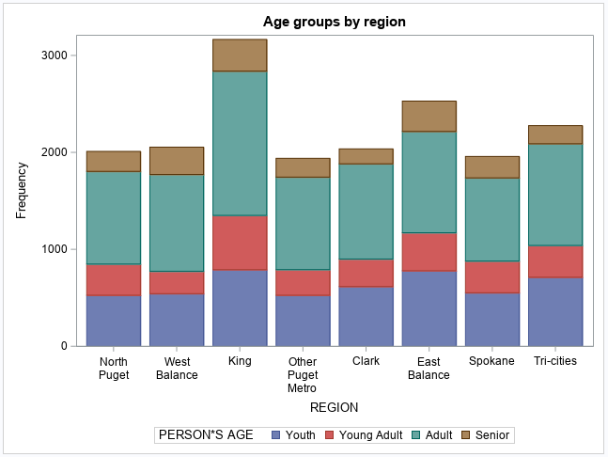
DESCRIPTIVE ANALYSIS
The overall targeted people is 28.52%

Slide 13
RESEARCH QUESTIONS
1) What are the top 3 regions that have more persons with disabilities?
2) Which top 2 age groups needs more attention
3) What are the top 3 Regions of unemployment?
4) What percentage of veterans have disabilities?

Slide 14
RESULTS/FINDINGS
The top 3 regions that have more persons with disabilities?
The top 2 age groups that need more attention
45.6%
Results shows that we need to pay more attention to Kids and Adult In the following region: King, West Balance and East Balance

Slide 15
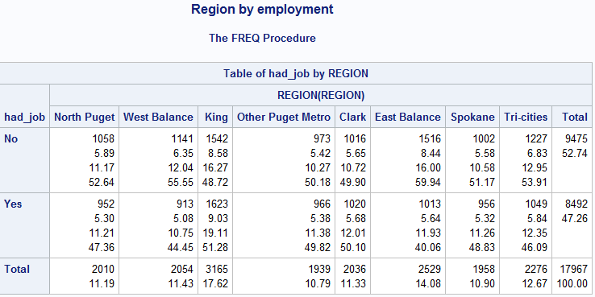
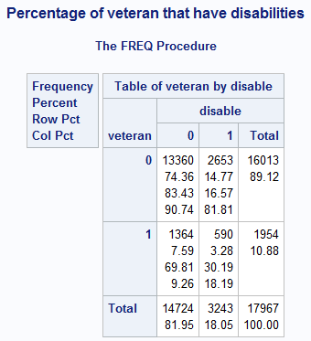
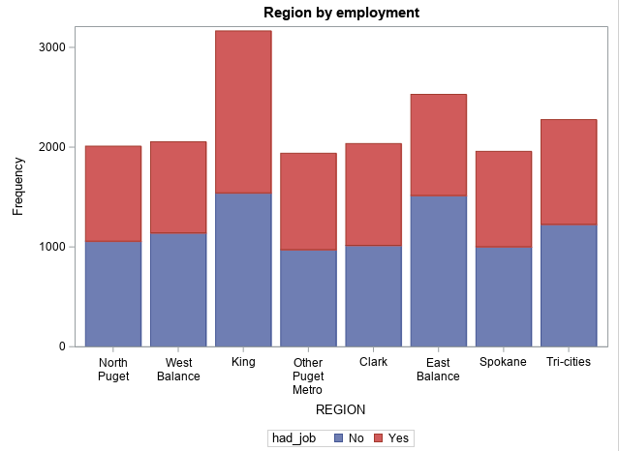
RESULTS/FINDINGS
The top 3 regions of unemployment
Percentage of veterans that have disabilities
The top 3 regions of unemployment are East Balance and Tri-cities and King
We identified 30.19 % of veterans that have disabilities

Slide 16
CONCLUSIONS
In Our analysis we identified 3 main regions that need focus of the department for the persons living with disabilities: King, West Balance and East Balance. These 3 regions cumulate 45% of the total
Furthermore the 2 age groups that need to receive attention are kids and adult
30% of veterans living in the state have disabilities
In term of employment, the top 3 regions that needs also attention are East Balance, Tri-Cities and King
With the variables choosen we were not able to determine the factors that increase unemployment

Slide 17
RECOMMENDATIONS
Analyze the insights with previous sensus data to see if there was an increase or decrease.
Start a new analysis with main variables to lookup the unemployment factors
Work with local public authorities in King, West Balance and East Balance regions to increase development projects for people with disabilities
Develop new and special programs for kids and adults with disabilities
Increase funds for veterans reinsertion
Reinforce programs that avoid kids to drop school
Reinforce learning with trade schools

Slide 18
APPENDIX / SAS CODES
*creating new dataset with variables retain for first business question;
data project.limited;
set project.demographic (keep = ID Q215P Q2P15 Q2P13M1 AGE REGION Q4P42 Q4P4A Q4P4B Q4P4C Q4P4D Q4P4E Q4P4F);
run;
*create new variables for disable;
data project.limited_1;
set project.limited;
if Q4P42 = 1 then disable = 1;
else if Q4P4A = 1 then disable = 1;
else if Q4P4B = 1 then disable = 1;
else if Q4P4C = 1 then disable = 1;
else if Q4P4D = 1 then disable = 1;
else if Q4P4E = 1 then disable = 1;
else if Q4P4F = 1 then disable = 1;
else disable = 0;
run;
*creating new dataset with variables retain for second business question;
data project.job;
set project.demographic (keep = Q2P17 AGE Q2P13M1 Q2P6 REGION Q4P42 Q4P4A Q4P4B Q4P4C Q4P4D Q4P4E Q4P4F Q4P6 Q4P3);
run;
data project.job_1;
set project.job;
if Q4P42 = 1 then disable = 1;
else if Q4P4A = 1 then disable = 1;
else if Q4P4B = 1 then disable = 1;
else if Q4P4C = 1 then disable = 1;
else if Q4P4D = 1 then disable = 1;
else if Q4P4E = 1 then disable = 1;
else if Q4P4F = 1 then disable = 1;
else disable = 0;
run;
proc format;
value regionfmt 1 = 'North Puget'
2 = 'West Balance'
3 = 'King'
4 = 'Other Puget Metro'
5 = 'Clark'
6 = 'East Balance'
7 = 'Spokane'
8 = 'Tri-cities';
run;
*creating format for age variable;
proc format;
value agegrp . = 'N/A'
Low - 13 = 'Kid'
14 - 17 = 'Youth'
18 - 29 = 'Young Adult'
30 - 64 = 'Adult'
65 - High = 'Senior';
run;
proc format;
value schoolfmt . = 'N/A'
1 - 3 = 'Lower level'
4 - 7 = 'Middle level'
8 - 10 = 'High level'
11 = 'Very high level';
run;

Slide 19
title 'Distribution of people by age group';
proc freq data = project.job;
table AGE;
format AGE agegrp.;
run;
proc sgplot data = project.limited;
vbar AGE;
format AGE agegrp.;
run;
title 'Distribution of people by region';
proc freq data = project.limited;
table region;
format region regionfmt.;
run;
proc sgplot data = project.limited;
vbar region;
format region regionfmt.;
run;
*Distribution of people with disabilities;
title 'Distribution of people with disabilities';
proc freq data = project.limited_1;
table disable;
run;
proc gchart data = project.limited_1;
pie disable;
run;
title 'Had paid job or Not';
proc freq data = project.job;
table Q4P3/missing;
run;
proc gchart data = project.job;
pie Q4P3/missing;
run;
title 'Had paid job or Not';
proc freq data = project.job;
table Q4P3/missing;
run;
proc gchart data = project.job;
pie Q4P3/missing;
run;
*Disable persons by region;
title 'Disabilities distribution by region';
proc freq data = project.limited_1;
table disable * region / CHISQ NOCOL NOROW;
format region regionfmt.;
run;
proc sgplot data = project.limited_1;
vbar region / group = disable;
format region regionfmt.;
run;
*Had a paid job by school level;
title 'Had a paid job by school level';
proc freq data = project.job;
table Q4P3 * Q2P17;
format Q2P17 schoolfmt.;
run;
proc sgplot data = project.job;
hbar Q2P17 / group = Q4P3;
format Q2P17 schoolfmt.;
run;
***** Top 3 regions of unemployment;
PROC SQL;
CREATE TABLE project.job_2 AS
SELECT * , COALESCE (Q4P3 ,0 )AS had_job
FROM project.job
;
QUIT;
proc freq data = project.job_2;
table Had_job;
run;
title 'Region by employment';
proc freq data = project.job_2;
table had_job * region;
format region regionfmt.;
format had_job jobfmt.;
run;
*Disabilities distribution by age group;
title 'Disabilities distribution by age group';
proc freq data = project.limited_1;
table disable * AGE / CHISQ NOCOL NOROW;
format AGE agegrp.;
run;
proc sgplot data = project.limited_1;
vbar AGE / group = disable datalabel = disable;
format AGE agegrp.;
run;

Slide 20
THANK YOU

